Slide 1


Understanding OADP in OpenShift: Core Components and Practical Examples
This presentation delves into the OpenShift API for Data Protection (OADP), exploring its core components, installation, configuration, and practical applications for ensuring robust disaster recovery for your OpenShift workloads.
Notes:
1

Slide 2

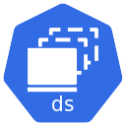
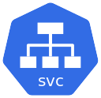


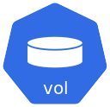

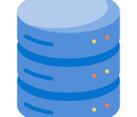



Namespace
Back up and Restore with OADP
VM
VM
VM
VM
VM
Virtual Machine
Data
Operating System
Interface
Interface

Slide 3
VELERO
KOPIA
CSI Plug-in
Cloud Provider Plug-ins
Openshift Plug-in
Backup Kubernetes resources
Data Mover
Backup File System
CSI Volume
snapshot
Native Volume
snapshot
Object Storage for backup
Backup Openshift resources
Backup Internal
Container Images
CSI Snapshot
Data movement
Notes:
Velero: Velero is the main upstream component of OADP. It provides the backup API to the users and uses plug-ins to add extended capabilities to OADP. Click
Data Mover: This feature enables exporting snapshot content to object storage by using Kopia and the CSI plug-in. Container Storage Interface
Kopia: Open source backup tool that Velero and Data Mover use to back up persistent volumes.

Slide 4


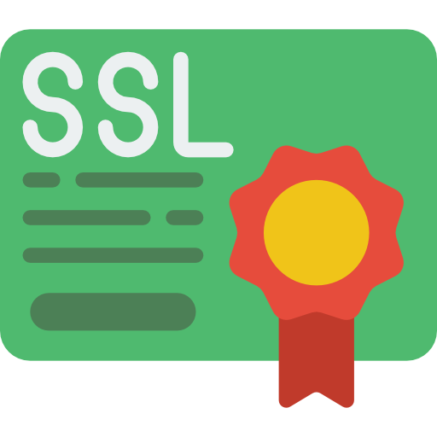
Ontab Server (S3)
SVM-1
bucket-1_customer1
bucket-1_customer2
192.168.1.10
access_key
Secret_key
access_key
Secret_key
192.168.1.11
SVM-2
bucket-1_customer3
bucket-1_customer4
access_key
Secret_key
access_key
Secret_key
Notes:
SVM (Storage Virtual Machine)

Slide 5
What is OADP? The OpenShift API for Data Protection
The OpenShift API for Data Protection (OADP) is a critical component for maintaining the resilience and recoverability of applications deployed on the OpenShift Container Platform. At its core, OADP empowers administrators to perform comprehensive backup, restore, and disaster recovery operations for their containerized environments. It acts as a shield for your applications, safeguarding not only the application code but also crucial associated data and configurations.
Comprehensive Protection
Exclusions for Clarity
Velero Foundation
OADP protects various aspects of your OpenShift environment, including containerized applications, their associated persistent volumes (PVs), cluster-scoped resources (like Custom Resource Definitions, Roles, RoleBindings), and internal image streams. This holistic approach ensures that a full application state can be recovered.
It's important to note that OADP is designed to protect workloads, not the underlying cluster infrastructure itself. Therefore, it specifically excludes the OpenShift etcd database (which stores cluster state) and OpenShift Operators from its backup scope. These components are typically managed through different disaster recovery strategies.
OADP is built upon the robust and widely adopted Velero open-source project, a Kubernetes native tool for backup and restore. However, OADP goes beyond a simple Velero deployment. It provides a tailored and enhanced integration specifically for OpenShift, including specialized plugins and APIs that leverage OpenShift's unique capabilities, offering a more seamless and optimized experience for data protection within the platform.
Notes:
2

Slide 6
Why OADP Matters: Disaster Recovery for OpenShift Workloads
In today's fast-paced digital landscape, ensuring business continuity and data integrity is paramount.
OADP plays a vital role in achieving this for OpenShift deployments by providing robust disaster recovery capabilities.
Without OADP, recovering from accidental deletions, data corruption, or catastrophic failures could lead to significant
downtime and data loss, impacting business operations and revenue.
Ensuring Business Continuity
OADP's primary function is to enable the backup of critical workloads and their associated data.
This ensures that in the event of an unforeseen disaster, applications can be quickly restored to a functional state,
minimizing downtime and maintaining operational integrity.
Versatile Workload Support
Beyond traditional containerized applications, OADP also extends its protection to virtual machines (VMs) running within OpenShift Virtualization.
This comprehensive support means that diverse application architectures can be safeguarded under a single data protection framework.
Flexible Backup Strategies
OADP provides powerful APIs that allow for highly customizable backup strategies.
Users can define exactly what resources to include or exclude from a backup, ensuring that only necessary data is stored, which optimizes storage consumption and restore times.
This fine-grained control is crucial for managing complex environments.
Scope Limitations
It's essential to understand OADP's scope. It is designed for workload recovery within namespaces and for specific cluster-scoped resources, but it does NOT support full OpenShift cluster backups or the recovery of the etcd database.
For full cluster disaster recovery, separate strategies for infrastructure-level backups must be implemented.
Notes:
3

Slide 7

Core Components of OADP: APIs That Drive Data Protection
OADP exposes a set of Kubernetes Custom Resource Definitions (CRDs) that serve as the primary interface for users to define and manage data protection operations.
These APIs abstract the underlying Velero functionality, making it easier to interact with the backup and restore processes.
Understanding each API's role is crucial for effective OADP utilization.
Backup API
Restore API
Schedule API
The Backup API is the cornerstone of OADP. It allows users to define what resources to include in a backup. This can range from specific namespaces, labels selectors to target particular applications, or even cluster-scoped resources. It also includes options to take snapshots of persistent volumes or include Velero's file-system-level backup. When you create a Backup object, OADP initiates the process of collecting the specified data and metadata.
The Restore API is used to bring backed-up data back into the cluster. A Restore object references an existing Backup object and specifies how the recovery should proceed. This can involve restoring to the original namespace, relocating resources to a new namespace, or even modifying resources during the restore process using Velero's restore hooks. It orchestrates the re-creation of applications and data.
The Schedule API automates the creation of recurring backups. Instead of manually triggering backups, you can define a schedule using cron-like syntax. This ensures that your applications are regularly backed up without manual intervention, which is essential for maintaining up-to-date recovery points and minimizing potential data loss. Each scheduled backup will create a new Backup object.
BackupStorageLocation API
VolumeSnapshotLocation API
The BackupStorageLocation API configures the remote storage where backup data will be stored. This typically points to S3-compatible object storage solutions, such as AWS S3, Google Cloud Storage, Azure Blob Storage, or on-premises solutions like Ceph or NetApp ONTAP S3. It defines the bucket name, region, and access credentials for secure backup storage.
The VolumeSnapshotLocation API defines where persistent volume snapshots are stored. While BackupStorageLocation is for application and metadata backups, VolumeSnapshotLocation is specifically for block-level snapshots of Persistent Volumes. This API interacts with the underlying Container Storage Interface (CSI) drivers to manage volume snapshots, which are crucial for fast and efficient recovery of application data.
Notes:
4

Slide 8
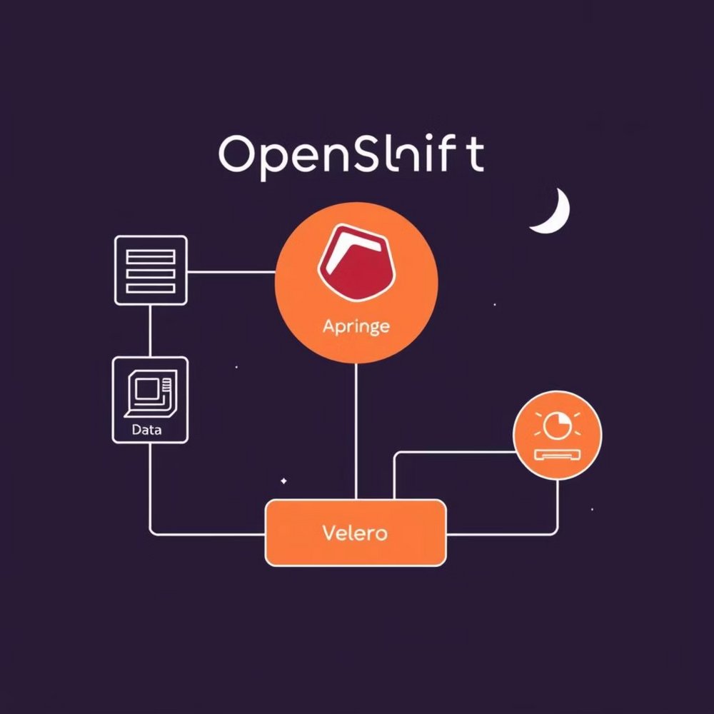
The OADP Operator: Installation & Configuration Essentials
The OADP Operator simplifies the deployment and management of OADP within your OpenShift cluster. It follows the Operator pattern, automating complex tasks such as installing Velero, deploying necessary plugins, and managing their lifecycle.
Installation via Operator Hub
The OADP Operator is easily installed directly from the OpenShift Operator Hub. Once installed, it typically resides in the openshift-adp namespace, ensuring a dedicated and isolated environment for data protection components.
The Operator deployment takes care of provisioning the core Velero pods, necessary custom resources, and RBAC configurations.
Automated Velero Deployment with OpenShift Plugins
A key advantage of the OADP Operator is its ability to automatically deploy Velero along with essential OpenShift-specific plugins. These plugins include:
CSI Plugin: For native integration with Container Storage Interface (CSI) drivers, enabling volume snapshots and restores across various storage backends.
Kubevirt Plugin: Specifically designed for backing up and restoring Virtual Machines managed by OpenShift Virtualization.
Cloud Provider Plugins (AWS/GCP/Azure): For seamless integration with major public cloud object storage and snapshot services.
OpenShift Plugin: Enhances Velero's understanding and handling of OpenShift-specific resource types.
Notes:
5

Slide 9
Crucial Backup Storage Configuration
Post-installation, the most critical configuration step involves setting up your backup storage.
This requires defining a BackupStorageLocation custom resource, pointing to your chosen S3-compatible object storage (e.g.,
NetApp ONTAP S3, StorageGrid S3, or any other compliant storage). You'll need to provide:
Access credentials (AWS Access Key ID and Secret Access Key).
The target S3 bucket name.
Region information (if applicable).
TLS certificates for secure communication, especially important for on-premises object storage.
Advanced Features: Data Mover
OADP supports advanced features like the Data Mover.
This capability allows for the efficient transfer of CSI snapshots directly to object storage.
This is particularly beneficial for scenarios where local snapshots might not be durable enough for long-term
retention or cross-region disaster recovery, providing an extra layer of data protection and portability.

Slide 10
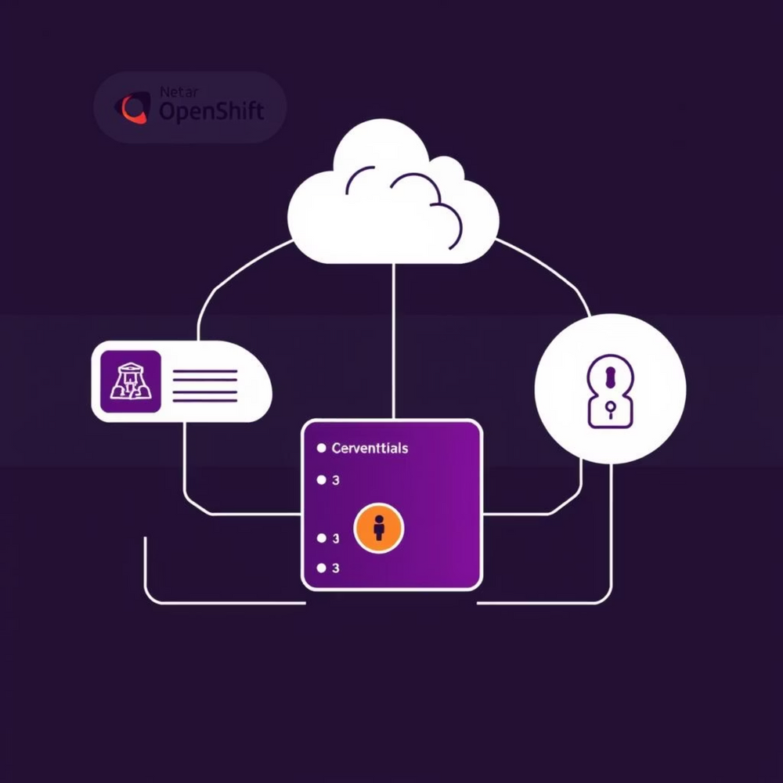
Example: Configuring OADP with ONTAP S3 Storage
To demonstrate a practical configuration, let's consider setting up OADP to use NetApp ONTAP S3 as the backup storage backend.
This involves creating a secret for credentials, a Certificate Authority (CA) bundle for TLS, and then defining the BackupStorageLocation and VolumeSnapshotLocation resources.
1. Create a Secret for S3 Credentials
First, create a Kubernetes secret in the openshift-adp namespace to store your S3 access key and secret key. This ensures that your credentials are securely managed and not exposed directly in your CRDs.
apiVersion v1
kind: Secret
metadata:
name: cloud-credentials
namespace: openshift-adp
type: Opaque
data:
cloud: |
[default]
aws_access_key_id=<YOUR_ACCESS_KEY_ID>
aws_secret_access_key=<YOUR_SECRET_ACCESS_KEY>
Replace <YOUR_ACCESS_KEY_ID> and <YOUR_SECRET_ACCESS_KEY> with your actual ONTAP S3 credentials.
Notes:
6

Slide 11
2. Create a ConfigMap for CA Bundle (if using custom TLS)
3. Define the BackupStorageLocation
If your ONTAP S3 endpoint uses a custom TLS certificate (not publicly trusted), you'll need to provide the CA certificate as a ConfigMap.
This CRD tells OADP where to store backups.
Specify the S3 bucket, endpoint, and reference the secret and CA bundle.
apiVersion: velero.io/v1
kind: BackupStorageLocation
metadata:
name: ontape-s3-bbl
namespace: openshift-adp
spec:
provider: aws
objectStorage:
bucket: <YOUR_S3_BUCKET_NAME>
prefix: backups/
config:
s3ForcePathStyle: "true"
region: default
s3Url: https://<ONTAP_S3_ENDPOINT>
credential:
name: cloud-credentials
key: cloud
config:
insecureSkipTLSVerify: "false" # Set to "true" if not using TLS or for testing
caCert: s3-ca-bundle
apiVersion v1
kind: ConfigMap
metadata:
name: s3-ca-bundle
namespace: openshift-adp
data:
ca.crt: |
-----BEGIN CERTIFICATE-----
... (your CA certificate content) ...
-----END CERTIFICATE-----
apiVersion v1
kind: Secret
metadata:
name: cloud-credentials
namespace: openshift-adp
type: Opaque
data:
cloud: |
[default]
aws_access_key_id=<YOUR_ACCESS_KEY_ID>
aws_secret_access_key=<YOUR_SECRET_ACCESS_KEY>
Replace <YOUR_S3_BUCKET_NAME> and <ONTAP_S3_ENDPOINT> with your ONTAP S3 details.

Slide 12
4. Define the VolumeSnapshotLocation
This CRD is for volume snapshots and references the CSI driver used by ONTAP.
apiVersion: velero.io/v1
kind: VolumeSnapshotLocation
metadata:
name: ontape-s3-vsl
namespace: openshift-adp
spec:
provider: csi
config:
csi.storage.k8s.io/driver: csi.trident.netapp.io
This comprehensive configuration ensures OADP can securely connect to your ONTAP S3 storage for both object and
snapshot-based backups, providing a robust foundation for your OpenShift data protection strategy.

Slide 13
Example: Backup and Restore of an Nginx Deployment
Let's walk through a practical scenario: backing up and restoring a simple Nginx web server deployment.
This will illustrate how OADP handles application resources and persistent volumes.
1. Deploy ApplicationNginx
First, ensure you have an Nginx deployment running in a dedicated namespace, e.g., nginx-app.
oc create namespace nginx-app
oc apply -f your-nginx-deployment.yaml -n nginx-app
Ensure your Nginx deployment includes a Persistent Volume Claim (PVC) if you want to demonstrate data backup.
For a simple Nginx, this might be for serving custom static content.
Notes:
7

Slide 14
2 Create a Backup
To back up the Nginx deployment, create a Backup object targeting the nginx-app namespace.
apiVersion: velero.io/v1
kind: Backup
metadata:
name: nginx-app-backup-001
namespace: openshift-adp # OADP Operator namespace
spec:
includedNamespaces:
- nginx-app
storageLocation: ontape-s3-bbl # Reference your BSL
ttl: 720h # Time-to-live for the backup (30 days)
hooks:
# Optional: pre/post hook to quiesce app or snapshot data
resources:
- name: pre-backup-exec
includedNamespaces:
- nginx-app
resourceHook:
exec:
container: nginx
command: ["/bin/bash", "-c", "echo 'Pre-backup hook executed'"]
timeout: 1m
onSetOwnerReference: true
Apply this YAML to your cluster. You can check the backup status using
oc get backup -n openshift-adp
or
oc describe backup nginx-app-backup-001 -n openshift-adp

Slide 15
3. Simulate Disaster (Delete Application)
To test the restore, simulate a disaster by deleting the nginx-app namespace and all its contents.
oc delete namespace nginx-app
Confirm that the namespace and all associated resources (Deployments, Pods, Services, PVCs) are gone.
4. Restore the Application
Now, create a Restore object to bring back the Nginx application from your backup.
apiVersion: velero.io/v1
kind: Restore
metadata:
name: nginx-app-restore-001
namespace: openshift-adp
spec:
backupName: nginx-app-backup-001 # Reference the backup to restore from
excludedResources: # Optional: Exclude resources during restore
- imagestreams.image.openshift.io
labelSelector: # Optional: Restore only specific resources by label
matchLabels:
app: nginx
# Optional: restore into a different namespace
# namespaceMapping:
# nginx-app: restored-nginx-app
Apply this YAML. You can monitor the restore process using “oc get restore -n openshift-adp” and “oc describe restore nginx-app-restore-001 -n openshift-adp”. Once completed, the nginx-app namespace should reappear with your deployment, pods, and any associated PVCs restored to their state at the time of backup.
Notes:
This example demonstrates the fundamental backup and restore workflow for an application, including the handling of persistent data through volume snapshots, which is crucial for stateful applications.

Slide 16
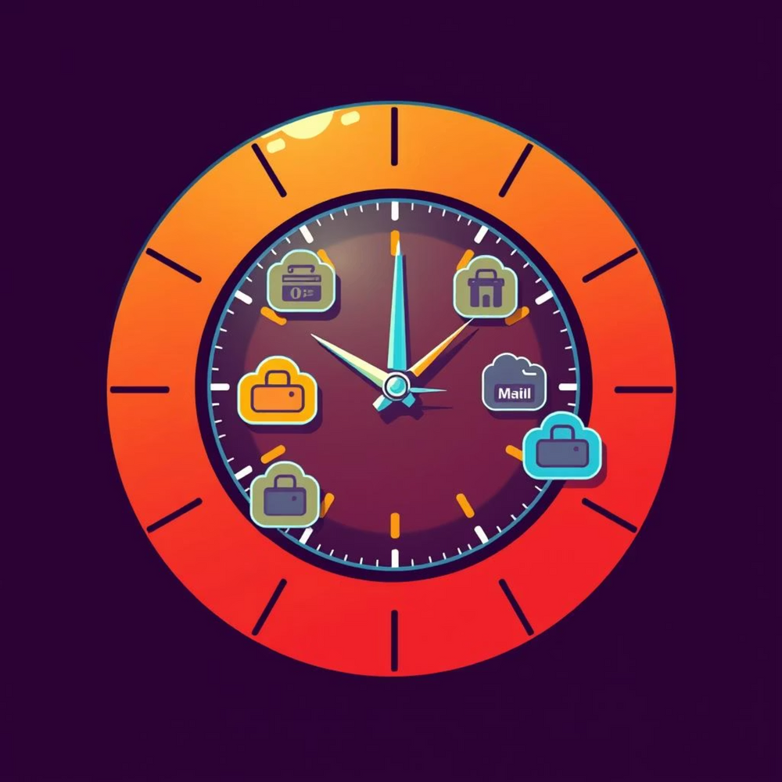
Example: Create a CronJob for taking backup and restore of Nginx Deployment
Automating backups is essential for any production environment. OADP leverages the Schedule API to define recurring backups, which are then managed by the OADP Operator, effectively acting as a CronJob for your data protection needs.
1. Create a Schedule for Daily Backups
To create a daily backup schedule for our Nginx application, we define a Schedule object. This object specifies when backups should occur and what they should contain, similar to a Backup object.
apiVersion: velero.io/v1
kind: Schedule
metadata:
name: nginx-daily-backup-schedule
namespace: openshift-adp
spec:
schedule: "0 1 * * *" # Daily at 1:00 AM UTC
template:
includedNamespaces:
- nginx-app
storageLocation: ontape-s3-bbl
ttl: 720h # Backups retained for 30 days
Apply this YAML. The OADP Operator will now automatically create a new Backup object every day at 1:00 AM UTC, ensuring that your Nginx application is regularly protected.
Notes:
8

Slide 17
2. Monitoring Scheduled Backups
You can monitor the created backups by listing the Backup objects in the openshift-adp namespace:
oc get backup -n openshift-adp
Each entry will correspond to a backup taken by the schedule, with a name typically following a pattern like nginx-daily-backup-schedule-<timestamp>.
3. Manual Restore from a Scheduled Backup
While the schedule automates backup creation, restoration remains a manual process triggered by a Restore object. You would select the specific backup (by its name) you wish to restore from.
apiVersion: velero.io/v1
kind: Restore
metadata:
name: nginx-restore-from-schedule
namespace: openshift-adp
spec:
backupName: nginx-daily-backup-schedule-20230101010000 # Replace with actual backup name
This cron-like scheduling mechanism provided by OADP's Schedule API is fundamental for implementing a robust and automated disaster recovery strategy for your OpenShift applications.
It eliminates the need for manual intervention, reduces human error, and ensures that recovery points are consistently available.

